Slide 1
Motion Exercise 1
Positioning

Slide 2
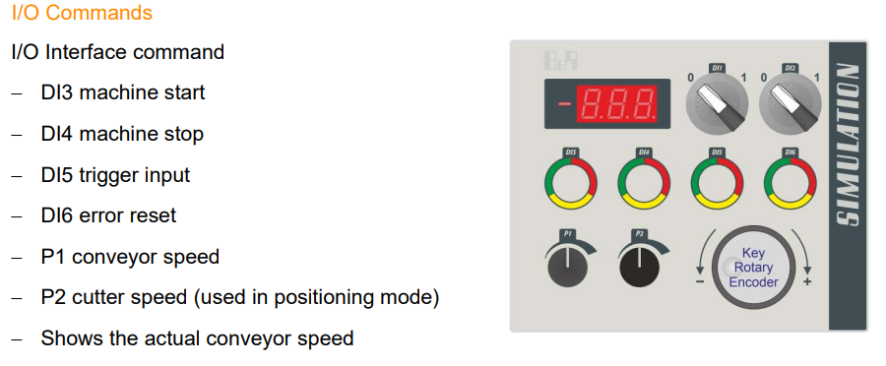
Device used: 4 SIM. 10-01 and Inputs and Outputs

Slide 3
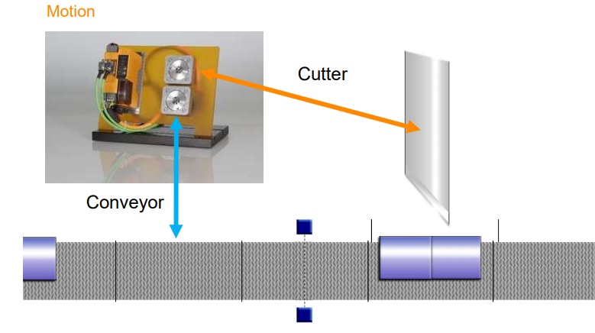
MACHINE_CONTROL
CUTTER_CONTOL
CONVEYOR_CONTORL

Slide 4
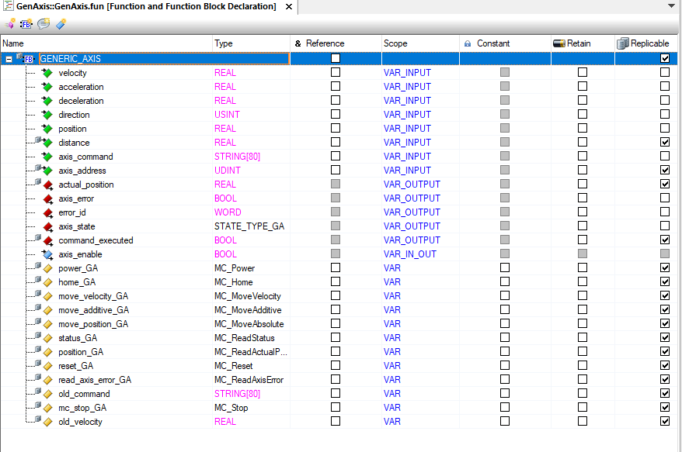
Generic Axis

Slide 5
Function Block : Generic Axis and PLCopen used
VAR:
power_GA : MC_Power;
home_GA : MC_Home;
move_velocity_GA : MC_MoveVelocity;
move_additive_GA : MC_MoveAdditive;
move_position_GA : MC_MoveAbsolute;
status_GA : MC_ReadStatus;
position_GA : MC_ReadActualPosition;
reset_GA : MC_Reset;
read_axis_error_GA :MC_ReadAxisError;
old_command : STRING[80];
mc_stop_GA : MC_Stop;
old_velocity : REAL;
Inputs:
velocity
acceleration
axis_enable
axis_command
distance
axis_address
position
direction
Outputs:
actual_position
axis_error
error_id
axis_state
command_executed

Slide 6
Generic Axis States
READY
POWERED
WAIT_POWER
NOT_POWERED
IN_VELOCITY_STATE
MOVE_POSITION_STATE
MOVE_ADDITIVE_STATE
MOVE_VELOCITY_STATE
STOPPING

Slide 7
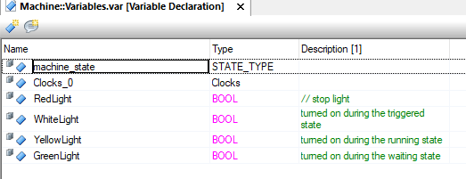
Machine Variables

Slide 8
Machine States
OFF_STATE (*the system is off*)
CONFIRM_INIT (*Wait to be powered*)
CONVY_MV_STATE (*running state and waits for a triggered state or be turned off*)
SENSOR_DETECT (*the system has been triggered and is getting ready for the cutting action*)
CUTTING_STATE (*the system performs the cut and gets ready to go back to running state*)
FAULT_STATE (Fault either in Conveyor axis or Cutter axis )

Slide 9
Machine workflow
OFF_STATE
CONFIRM_INT
NOT Conv init
CONVY_MV_STATE
SENSOR_DETECT
Start button
NOT Cutt init
White_Button
SENSOR_DETECT
CUTTING_STATE
CONVY_MV_STATE
activate_cut
NOT conv_stop
NOT activate_cut

Slide 10
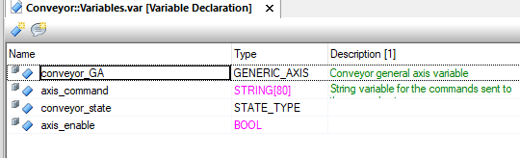
Conveyor Variables

Slide 11
Conveyor States
OFF_STATE_CONVEYOR (*Off state*)
INIT_AXIS (*Initialization of the general axis*)
CONFIRM_CONV_MV (*Enabling of the axis relative to the conveyor*)
CONV_MOVING_STATE (*Initialization of the movement of the conveyor and relative variables*)
CONV_STOPED, (*Stopping of the movement of the conveyor and setting of the relative variables*)
AXIS_ENABLED
FAULT_STATE_CONVETOR
(Fault either in Conveyor axis or Cutter axis )

Slide 12
Conveyor workflow(Master)
Conv init
INIT
AXIS
AXIS ENABLED
OFF STATE
CONFIRM_CONV_MV
NOT axis_enabled
move_conv
Cmd_exct
CONV_STOPED
CONV_MOVING_MV
Conv_stop

Slide 13
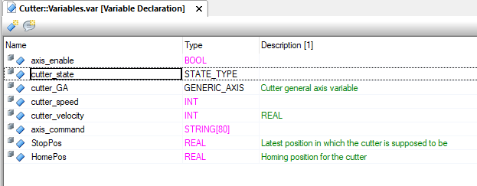
Cutter Variables

Slide 14
Cutter States
INIT_AXIS (*Initialization of the general axis*)
AXIS_ENABLED (*Enabling of the axis relative to the conveyor*)
CUTTER_MV_DOWN
CUTTER_MV_UP
OFF_STATE (*Off state*)
FAULT_STATE_CUTTER

Slide 15
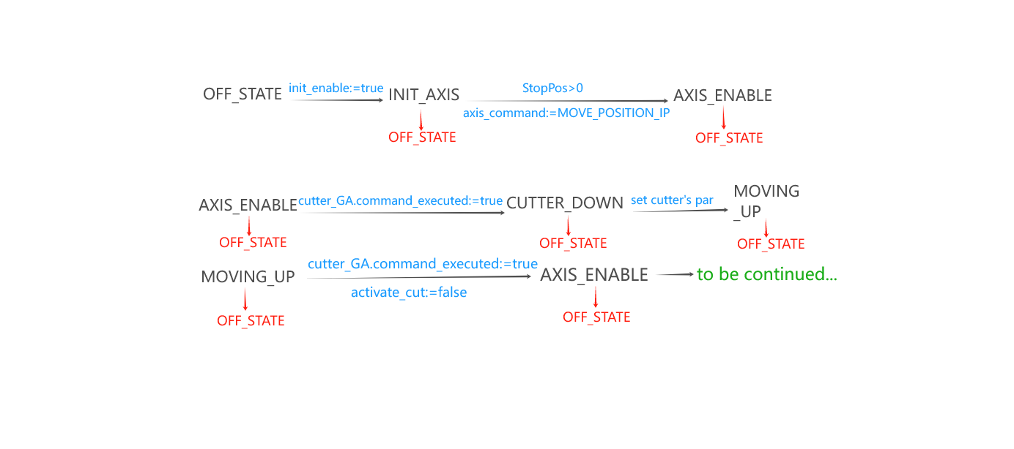
Cutter workflow(slave)

Slide 16
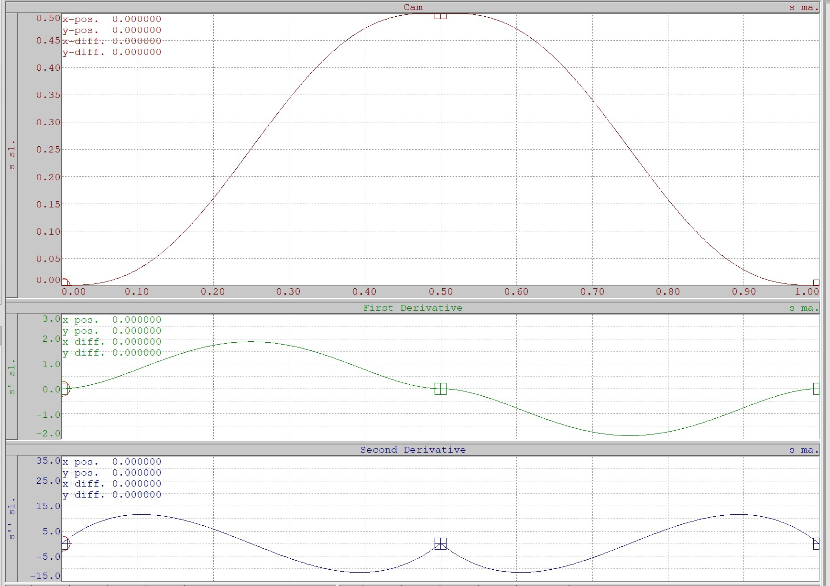
CAM PROFILE

Slide 17

Error Management
CONVEYOR_CONTORL:
IF(FAULT) THEN
axis_command := ‘STOP’;
conveyor_state := FUALT_STATE_CONVEYOR;
END_IF;
MACHINE_CONTROL:
IF(ConveyorError OR CutterError) THEN
FAULT := TRUE;
stop_machine := TRUE;
MACHINE_STATE:= FUALT_STATE;
END_IF;
CUTTER_CONTOL:
IF(FAULT) THEN
axis_command := ‘STOP’;
cutter_state := FUALT_STATE_CUTTER;
END_IF;

